Slide 1











Slide 2


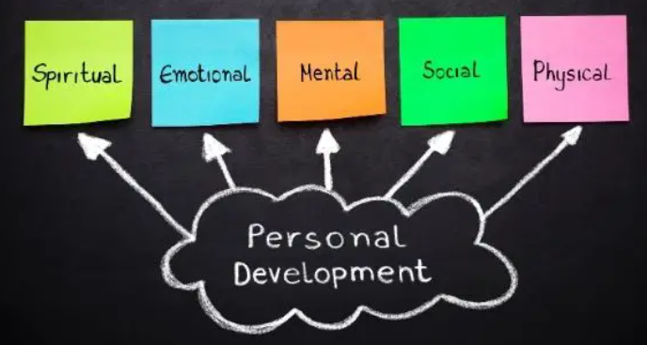
What is ‘personal development?’
Personal development refers to any activity, support or learning that helps pupils develop the knowledge, skills and attributes they need to keep themselves healthy and safe, and prepared for life and work with an impact on academic and non-academic outcomes. At our school we aim to do this by:
developing responsible, respectful and active citizens
promoting equality of opportunity
promoting an inclusive environment developing pupils’ character, giving them qualities they need to flourish in society
developing pupils’ confidence and resilience so that they can keep themselves mentally healthy preparing pupils for the next phase of education

Slide 3


Slide 4
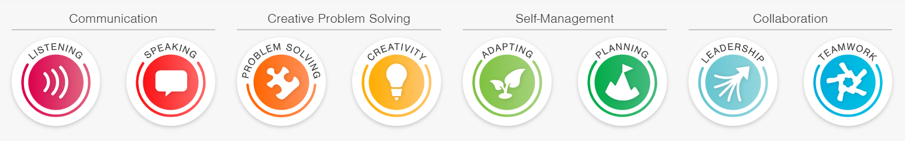




To help our children achieve our personal development aims, we have introduced the Skillsbuilder programme into our daily provision, as we recognise the research that shows that children need to develop eight essential skills to succeed in life.
Our children will have explicit teaching of each of the skills within a weekly class session and within frequent whole school assemblies presented by Mr Johnson focusing in on a specific skill. In the Spring Term, we are focusing on
Speaking and Listening to ensure that our children understand what it means to be a Confident Communicator.
Our children are also now earning recognition for when they demonstrate these skills in lessons, earning praise for their own individual skills development, whilst also earning house points for their house, helping them to develop their understanding of teamwork and becoming more aware of the role as Community Champions.

Slide 5
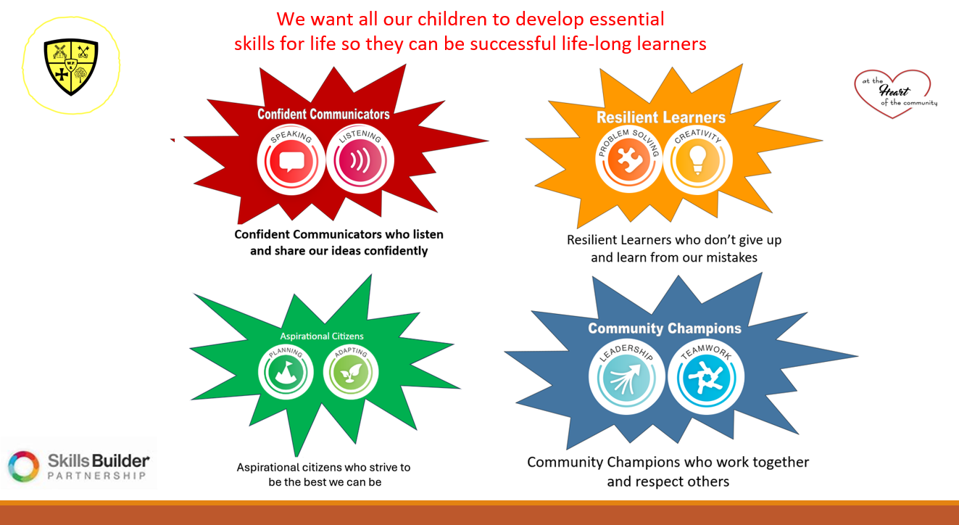

Slide 6
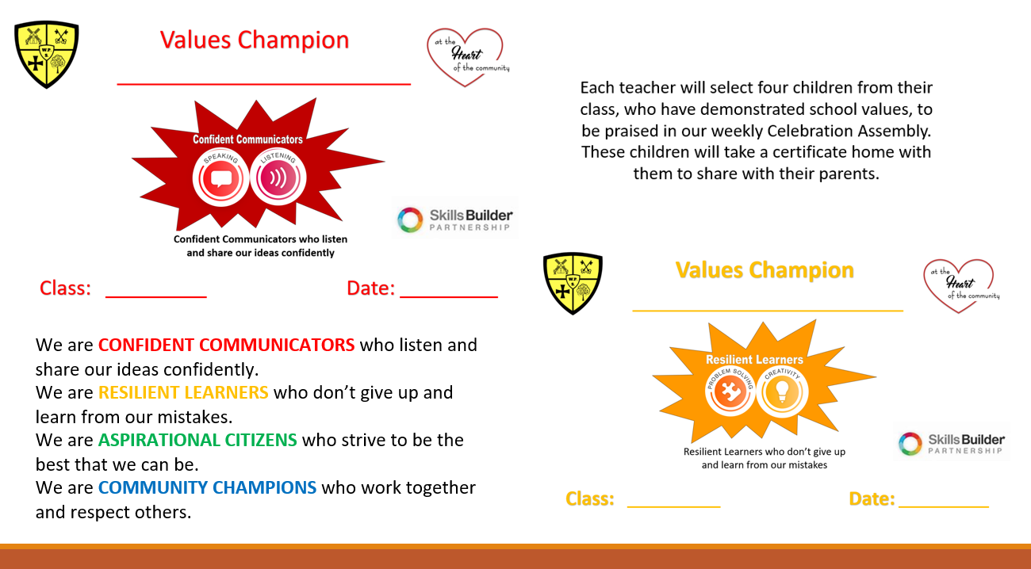

Slide 7


Slide 8
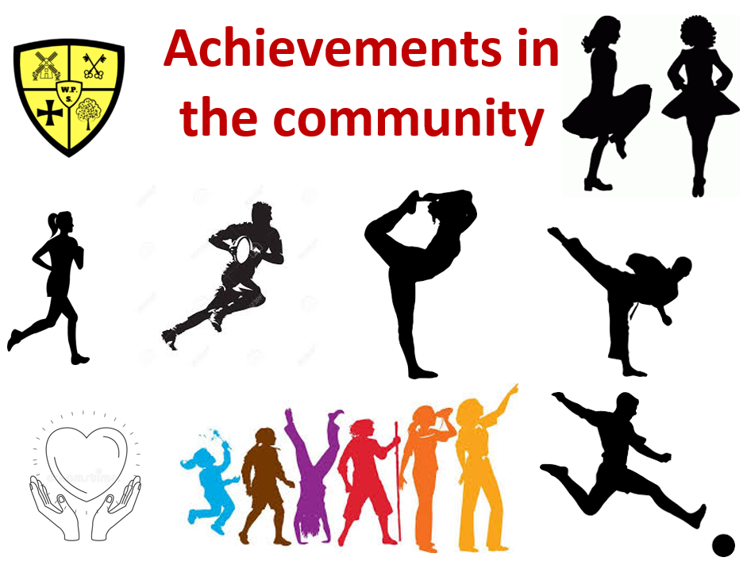

Slide 9






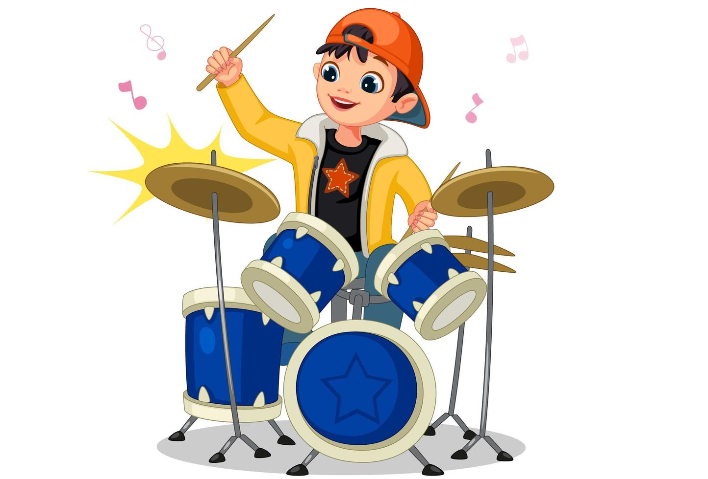


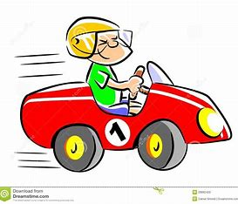


Achievements in the Community

Slide 10

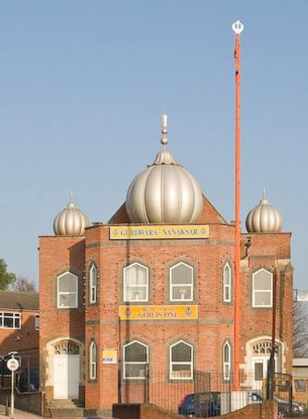
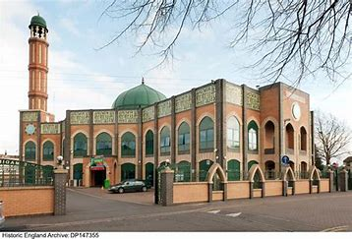
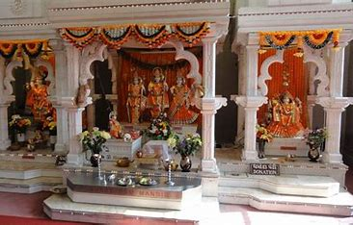
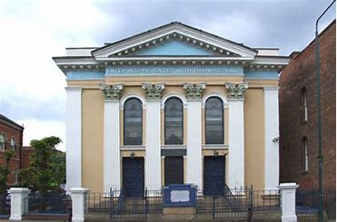
We have mapped out visits to places of worship where possible, to give our children the physical experience of different religions, so they can understand and therefore respect different religious customs and beliefs.
We also hold whole school assemblies to share and celebrate all major religious festivals.

Slide 11

Through our RE curriculum and assemblies to share and celebrate festivals of the major religions
Through developing our class rules and positive reward and sanction systems
Through our school values, PSHE curriculum and work around equality, kindness and respect
Through taking part in elections and voting for various choices and responsibilities, e.g. school council, house captains, choice of house names
Through our PSHE curriculum, opportunities to take part in discussions, voting and opportunities to step up into leadership

Slide 12
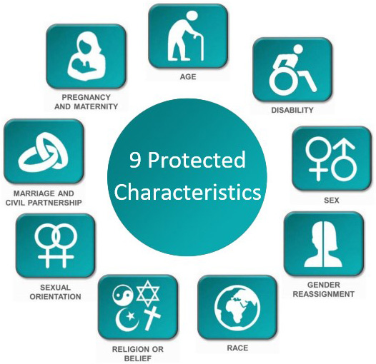
We are an inclusive school
Through our everyday teaching and approach of sharing and celebrating difference so we respect and see all people as people. We hold a firm belief in equality and equal rights.
Taught and discussed within our PHSE curriculum and highlighted within our learning journey document
We welcome all people as equal

Slide 13

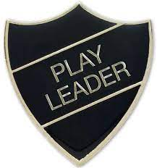

Stepping up
into Leadership
Our Y5 children have taken on the responsibility of being our Playground Leaders at lunchtime.
Our playground is divided up into ‘safe play zones’ with a range of activities going on to make our
Lunchtime structured and well-managed.

Slide 14


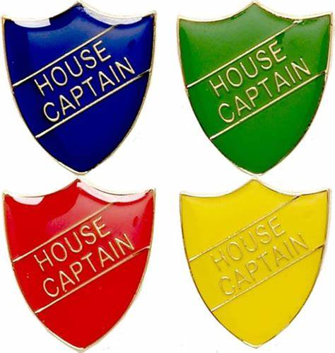

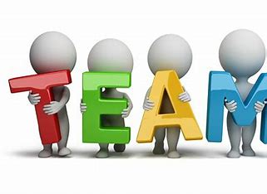









Stepping up into leadership
Children have many opportunities to step up into leadership in our school and can either run as candidates for our school council or house captain roles, or volunteer to take part in our Eco Club and E-Safety Team.
Our children have also stepped up to take the lead and run several clubs in our school, with more looking forward to next term when they can run additional clubs at lunchtime!

Slide 15


Slide 16
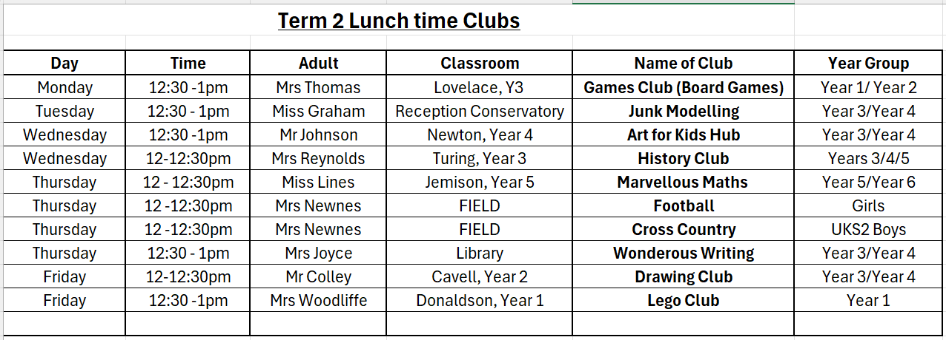

Slide 17

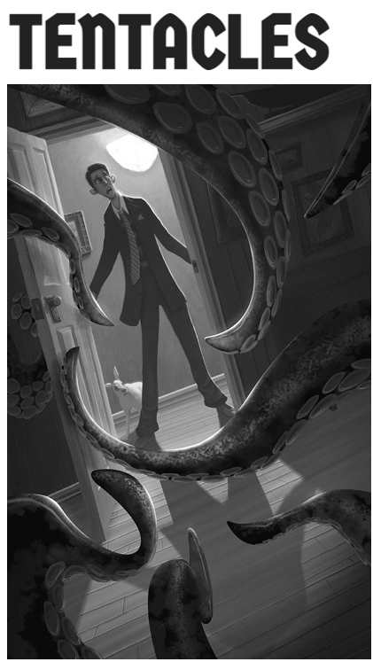
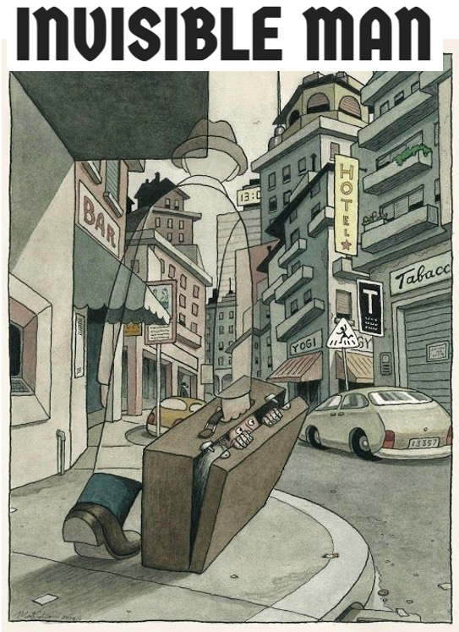


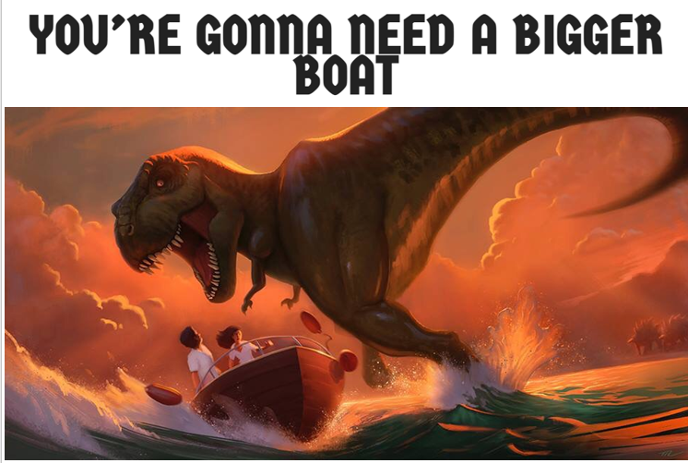
Building on the ‘Free Write’ initiative in school, where we are aiming to develop a ‘Love of Writing’, Mr Johnson offers an after school club called AWESOME AUTHORS. We discuss an image, brainstorm some amazing vocabulary, then get
Time to be Awesome!
We edit our work using ‘red pen’ so we can revise and improve our vocabulary choices and sentence construction to make us even-better writers!
We share our stories with each other and upload them to SEESAW, so our parents can share in our writing!

Slide 18


Slide 19
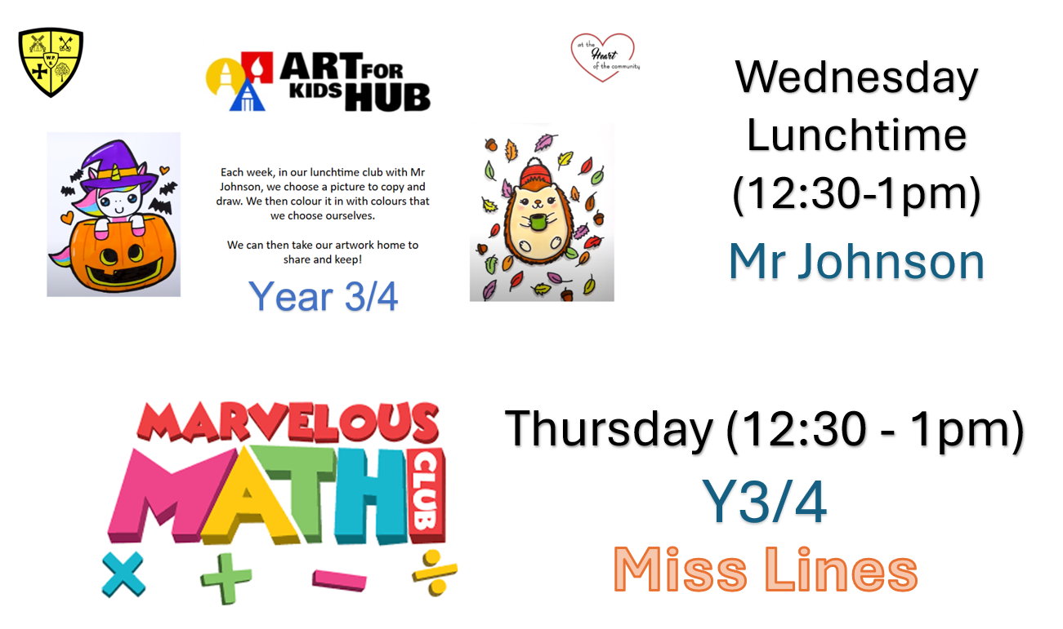

Slide 20
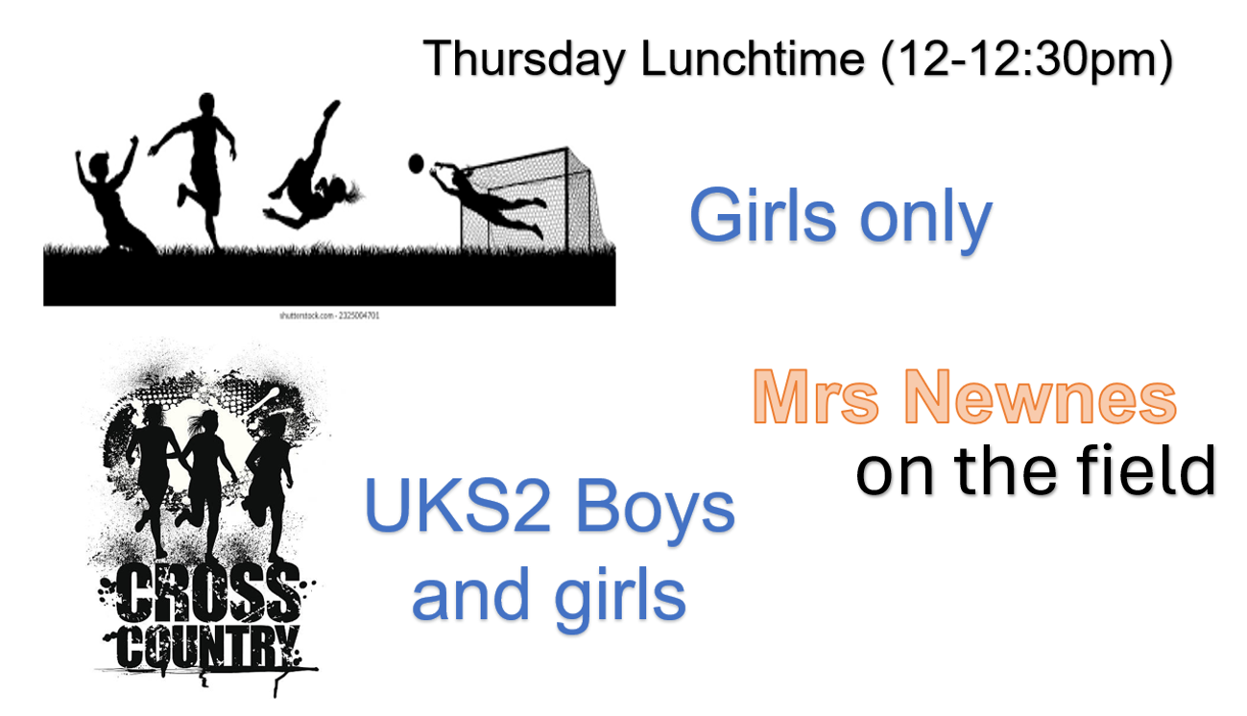

Slide 21
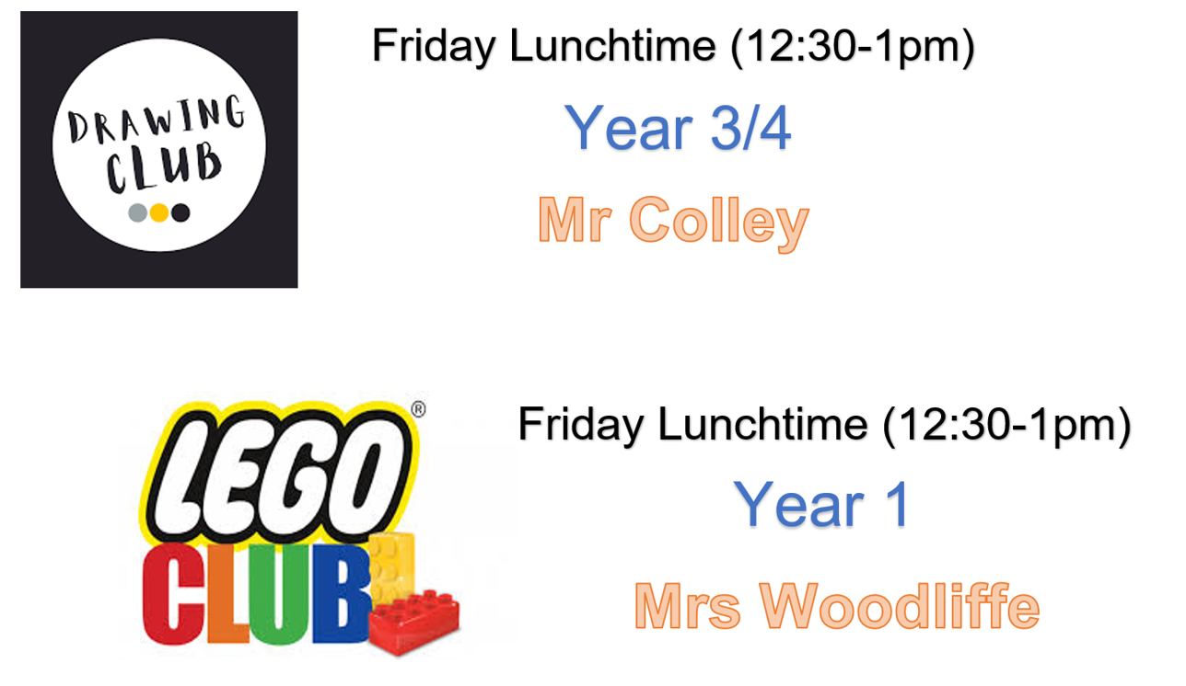

Slide 22
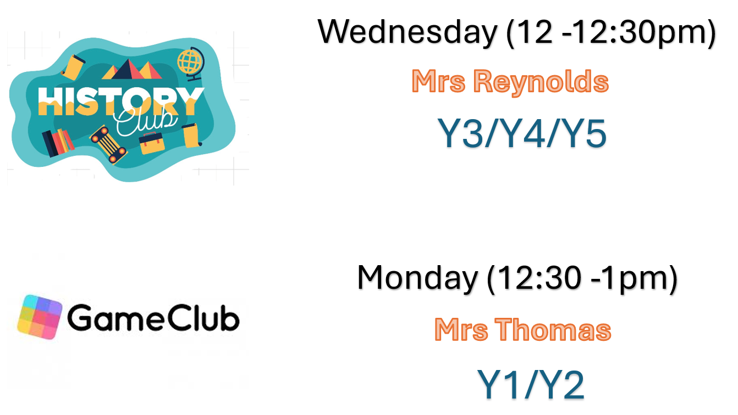

Slide 23
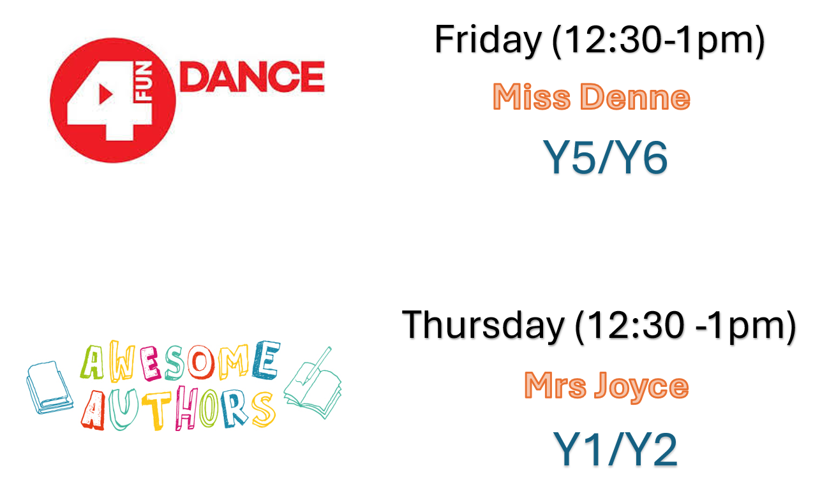

Slide 24


