Slide 1


Exploring identity online
Assembly for ages 3-7

Slide 2
















What is your identity?
What makes you…
YOU?

Slide 3
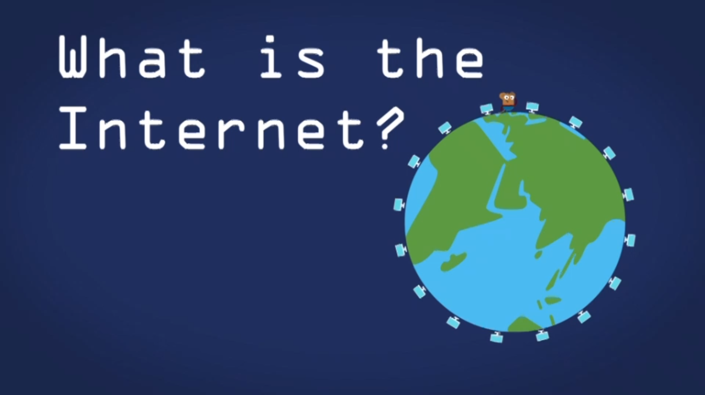
What is the internet?
Notes:
Click picture to link out to BBC Bitesize video - https://www.bbc.co.uk/bitesize/articles/zgwnsbk

Slide 4
















What uses the internet?

Slide 5

This is me!
A poem about online identity

Slide 6


The internet’s a super place,
To play, to learn, to chat.
A space for us to be ourselves,
So let’s remember that.

Slide 7

Need a book? Well search no more,
Pop one on your device.
Sit down, relax and snuggle up,
Doesn’t that sound nice!

Slide 8


Feeling glum? A little tired?
To take away your gloom…
Just listen to your favourite tunes,
And bop around the room!

Slide 9



Can gorillas doodle?
A question’s buzzing in your head,
Can gorillas doodle?
Oh wow, it seems the answer’s yes,
You found out thanks to Google!

Slide 10
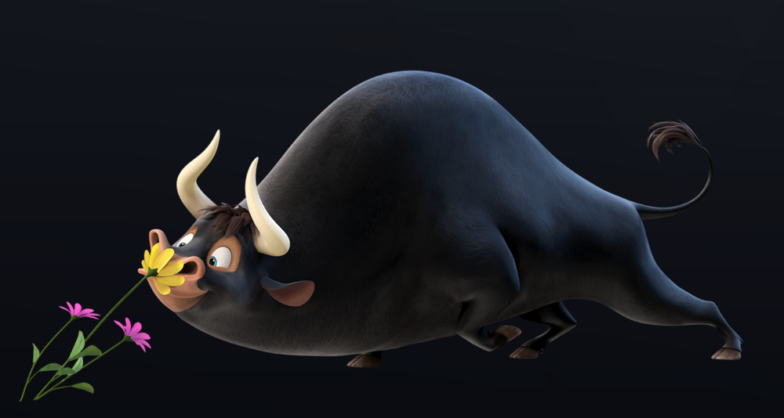
You’re off on hols, the drive is long,
To pass away the hours,
You watch a film about a bull,
Who loved to smell the flowers.
© 2017. 20th Century Fox

Slide 11

Your cousins live across the world,
A thousand miles away.
But thanks to WiFi, face to face,
You see them every day!

Slide 12


Which super power do you have?
Fly, hide, stretch or whizz?
There’s just one way to find it out,
Take an online quiz!

Slide 13


It’s your birthday, lucky you!
Your cake is just sublime.
You take a pic to show your gran,
And share with her online.

Slide 14



You love a funny video,
Of pandas, cats or puppies.
And a football-loving horse called Ace
Who’s great at keepy-uppies!

Slide 15


You crave adventure, games and fun,
You play on many teams.
You build your castles and your lands,
And live your wildest dreams.

Slide 16

But wait, there’s more that you can do,
Buy tickets, gifts, or food.
New clothes are a click away,
To look the awesome dude!

Slide 17

It’s great to share your favourite things,
With friends across the nation.
But keep offline, and just for you,
Your personal information.

Slide 18

If you’re online and feeling sad,
Worried, or upset,
Tell a grown-up straight away…
It’s the best help you can get!

Slide 19



The safety tools are always there,
To keep things running well.
Block, report or flag it up,
It’s important that you tell.

Slide 20

No two people are alike,
Even if you’re twins.
Be yourself and keep in mind,
That kindness always wins.

Slide 21
There’s just one you and you are FAB,
I think that you’ll agree.
Express yourself and make some noise,
Jump up, shout…

Slide 22


Slide 23



